Slide 1
BYOD Implementation
Student Name:
Institution Affiliation:

Slide 2

Introduction
Mobile device efficiency
Mobile device usability in work-related issues
Main purpose of the presentation
Notes:
Mobile devices are very persuasive hence can act as a motivating factor tom any a activity being performed when they are being utilized.
There is excessive usage o mobile devices in many work places to carry out organizational activities.
Different personnel in work place uses mobile devoices on daily bases as they try to perform the assigned duties.
There is no restrict on who to use and who not to make use of them.
Several researches shows that different organizations have made numerous attempts of incorporating mobile devices to the work-place related issues including even purchasing of organization devices and outsourcing mobile providers.
This presentation will focus on why and why not BYOD Program should be implemented in organizations.
The benefits and risks of this program will be in-depth capture in different slides.
Finally a recommendation on what organizations need to do will be given.

Slide 3
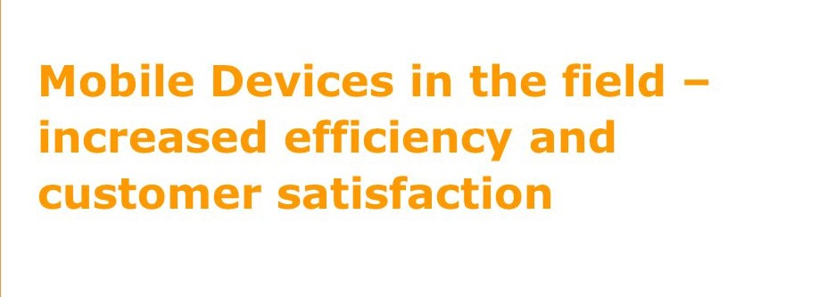
BYOD Benefits
Increased efficiency
Mobile device adaptation
Mobile device ownership
Non-restriction to mobile device access
Notes:
Employees are always used to their mobile devices hence once allowed to use them for work-related issues, they will have 100% knowledge of the device they are using hence no chance of making any mistake in performing their duties.
The precise understanding of the devices they use on daily basis will make them to always take the shortest time possible to perform certain job tasks hence increasing efficiency.
The feeling of the ownership of the devices they are currently using to perform their duties will enable them undertake their work more efficiently.
Since employees will not be restricted to the usage of their mobile devices that is they can use them to undertake personal activities and work-related issues, work efficiency will generally increase (Pinchot, & Paullet, 2015).

Slide 4
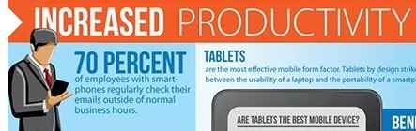
BYOD Benefits
Increased Productivity
Precise work or tasks completion
Minimal training for new employees and new programs incorporated
Organizational ownership
Notes:
Since employees will be using their mobile devices, they will be able to complete their job tasks while outside their wok places.
For instance, after the working hours are over while an employee has some pending task, they can go and complete undertaking them art their homes since they can aces the company settings using their mobile devices.
When an organization launches a new program while employees are allowed to use their devices, less training will be required to be done to the employees since the training bon the devices usage to perform the program activities won’t be necessary (Pinchot, & Paullet, 2015).
Also, when new employees are recruited in a firm and Allowed to use their devices to perform their duties, less training of other company activities except the mobile devices usage will be necessary.
The employees will be motivated by the fact that they are using their personal devices hence even have the feeling of organization ownership. All these in the long run will increase the productivity in an organization.

Slide 5

BYOD Benefits
Reduced Cost and Increased Employee Collaboration
Precise workers collaboration
Cost cutting
No extra organizational costing
Notes:
Utilization of personal mobile devices for work related issues will create more intense collaboration between the employees.
Company social media platforms will remain active all the time and employees will be able to have access to each other and discuss more organizational issues that would spear head the organization forward.
Further, the employees will have an easy way of reaching out to organization clients while using bather mobile devices (Pinchot, & Paullet, 2015).
Next, organizations will be able to cut off all purchasing and maintenances costs of workplace mobile device's used for only workplace purposes since employees will be able to utilize their personal devices.
Device replacement costs in instances of severe damage or loss will not be incurred by an organization but by an individual.

Slide 6
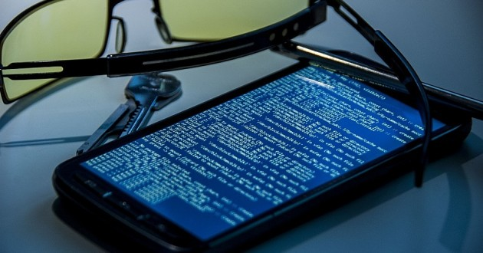
BYOD Risks
Mobile Malware
Personal and work related issues mix
Malicious Android Apps
Family Influence
Notes:
Employees will have to use the same mobile devices to undertake personal issues as well as work-related tasks which increase exposure of confidential organizational data to mobile cyber threats.
Most employees use the different Android operating systems which are the recent targets by mobile cyber criminals.
The can use the Android operating systems to spy individuals mobile and in that process aces organizational confidential data hence threatening the company success (Teneyuca, 2011).
Employees will most of the time download and use malicious Android apps which were noted to have increased significantly in the year 2016 hence exposing confidential organization data to a risk.
Further, Employees will always get influence from family members of the use of several Applications or blogs which increase the risk of mobile malware.

Slide 7
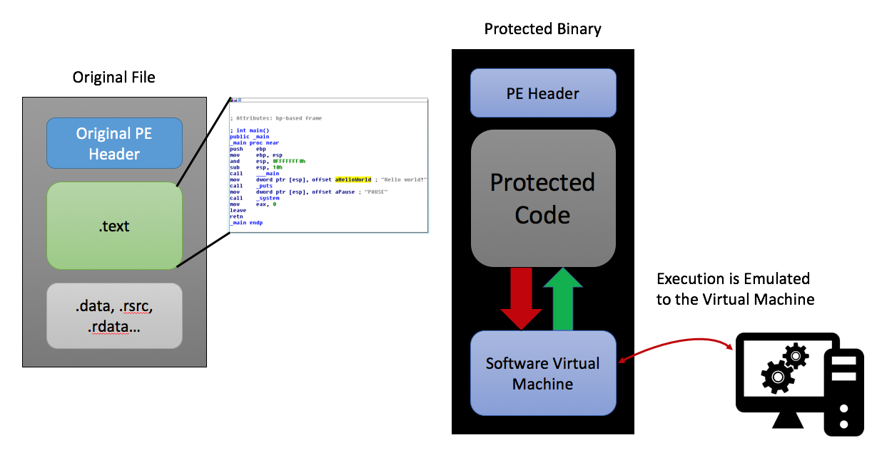
BYOD Risks
Increase in Runtime Packers
Mobile infection success and longevity increase
Mobile malware obfuscation
Mobile malware detection challenge
Notes:
Mobile hackers find it difficult to innovate new methods of successfully hacking the new technical mobile operating systems hence making use of the runtime packers technique that will increase the infection success rates and longevity.
Runtime packers will be commonly used by mobile hackers in the attempt to obfuscate malware hence exposing organizational confidential data into a risk (Teneyuca, 2011).
Further, Runtime Packers will make it a challenge to detect mobile malware hence an organization can operate for long time as hackers are spying on it through an employee mobile device.

Slide 8

BYOD Risks
Employee Exploitation
Difficulty in overtime claim navigation by the employees
Difficulty in determination of reimbursement claims
Notes:
Since employee will always use the same device to undertake personal activities and work-related issues, it will be a challenge for the organization management to determine the overtime claims by the employees since no one has been monitoring if its true during overtime hours the employees were undertaking work-related issues or personal activities.
Further, due to the mix personal and work-related usage of mobile devices, employees will have difficulty in determining and claiming reimbursement of incurred costs such as long distance fees and client calls (Pinchot, & Paullet, 2015).

Slide 9
BYOD Risk Mitigation
In order to mitigate the risks involved in the use of Mobile devices in work-related issues, the organizations need to advice the employees to;
Keep their mobile devices up to date
Refrain from downloading apps from unfamiliar sites and only install aps from trusted sources.
Always pay close attention to permissions requested by apps
Always keep a suitable mobile security app such as Norton installed in their devices.
Make frequent back up of all company data.
Notes:
By the each organization management ensuring that their employees keep their devices up to date, they do not download and install applications in their devices from untrusted sites, always pay a very close attention to different permissions that apps request while being installed, they keep security apps in their devices and lastly they make frequent organization data back up, most malware threats may be minimise.
Minimization of malware threats implies that the organization can successfully implement BYOD program to help increase organization performance (Teneyuca, 2011).

Slide 10
BYOD Potential Risk Remediation
To remediate the risks involved in employees using personal mobile devices in work-related issues, the organizations should;
Always keep track of all employees mobile devices used for work-related issues
Always have a mobile administrator for running employees devices when they are at work-place each that they can-t access work-place confidential data while out of office.
Have a an automatic termination of mobile device from accessing work0related issues when an employee employment is terminated.
Notes:
However, it is possible that companies can implement BYOD programs and operate without the company getting any threats.
This however can happen under strong organizational leadership. The leadership need to always keep track and monitor from a common point all employees devices that are used for work-related issues to ensure that the employee does not carry out issues that put the company to a greater risk (Teneyuca, 2011).
Also each company needs to employ a mobile administrator to always run employees devices when they need to use them for job related issues and also totally disconnect employees whose employment contracts get terminated from accessing any organization details using the their devices.

Slide 11
Conclusion
BYOD Implementation Benefits
BYOD Implementation Risks
BYOD Implementation Potential risk mitigation and remediation
Notes:
The implementation of BYOD to organizations will result to various benefits which will relatively increase organizations performance and in the long run enable the company to achieve higher profitability levels.
However, implementation of any device to any organization has to have effects on it. Therefore implementation of BYOD in organizations expose the firm to higher mobile threats.
Therefore I do recommend that every organization has to be very conscious during the implementation of the program.
Some employees may utilize such opportunities to work close to cyber goons hence interfering with all company operations.
Even if the employees use their devices, there has to be guideline to the work-related issues.

Slide 12
References
Pinchot, J., & Paullet, K. (2015). Bring your own device to work: benefits, security risks, and governance issues. Issues in Information Systems, 16(3).
Teneyuca, D. (2011). Internet cloud security: The illusion of inclusion. Information Security Technical Report, 16(3-4), 102-107.

